Slide 1
Promotion to associate professor with tenure Workshop
February 19, 2025
Notes:
WELCOME
THANK YOU FOR ATTENDING THIS WORKSHOP
I’LL KICK THINGS OFF WITH SOME INFORMATION ABOUT PROCESSES AND POLICIES, INCLUDING PERCEPTIONS AND OUTCOMES AND A BIT ABOUT COVID ADAPTATIONS….
THEN I WILL TURN IT OVER TO SOME GUEST SPEAKERS TO TALK ABOUT P&T FROM A VARIETY OF PERSPECTIVES.

Slide 2
AGENDA
P&T Outcomes
P&T Process
P&T Best Practices
Key Resources
Perspectives
Department head’s
Dean’s
University P&T committee’s
Recently promoted faculty
Questions and Discussion
Notes:
OUTLINE OF OUR TIME THIS AFTERNOON:
ABOUT AN HOUR FOR PRESENTATIONS
ANOTHER HOUR FOR Q&A AND DISCUSSION
I’LL KICK THINGS OFF WITH SOME INFORMATION ABOUT PROCESSES AND POLICIES, INCLUDING OUTCOMES AND A BIT ABOUT COVID ADAPTATIONS….
THEN I WILL TURN IT OVER TO SOME GUEST SPEAKERS TO TALK ABOUT P&T FROM A VARIETY OF PERSPECTIVES.
WHERE I WOULD LIKE TO INTRODUCE:
Renee Boyer, HEAD OF FOOD SCIENCE & TECHNOLOGY
Dan Givens, DEAN OF THE VIRGINIA-MARYLAND COLLEGE OF VETERINARY MEDICINE WHO WILL…
Valerie Thomas, A RECENT MEMBER OF THE UNIVERSITY P&T COMMITTEE WHO WILL…
Panel of Recently promoted faculty: Dong Dong, Electrical and Computer Engineering
Karen Kitchens, Political Science
Michael Schulz, Chemistry
I WOULD ALSO BE REMISS IF I DIDN’T INTRODUCE CYNDI HUTCHISON WHO HANDLES P&T IN THE PROVOST’S OFFICE…

Slide 3
P&T Outcomes
Ron fricker, vice provost for faculty affairs

Slide 4
PROMOTION AND TENURE SUCCESS 2014-2024
Notes:
THIS IS THE PAST 10 YEARS OF DATA SHOWING THE PERCENT OF TENURE-TRACK FACULTY WHO ARE SUCCESSFUL AT ACHIEVING TENURE BEGINNING FROM WHEN THEY WERE HIRED.
NOTE THAT IN THE PAST THREE YEARS, ABOUT 19 OF 20 FACULTY DO GET TENURED….ONE OUT OF 20 DO NOT.
HIGH RATE IS A REFLECTION OF THE EXCELLENT JUNIOR FACULTY WE HIRE AND SUCESSFUL DEVELOPMENT OF THEM, INCLUDING MENTORING.

Slide 5
P&T PROCESS
Ron fricker, vice provost for faculty affairs

Slide 6
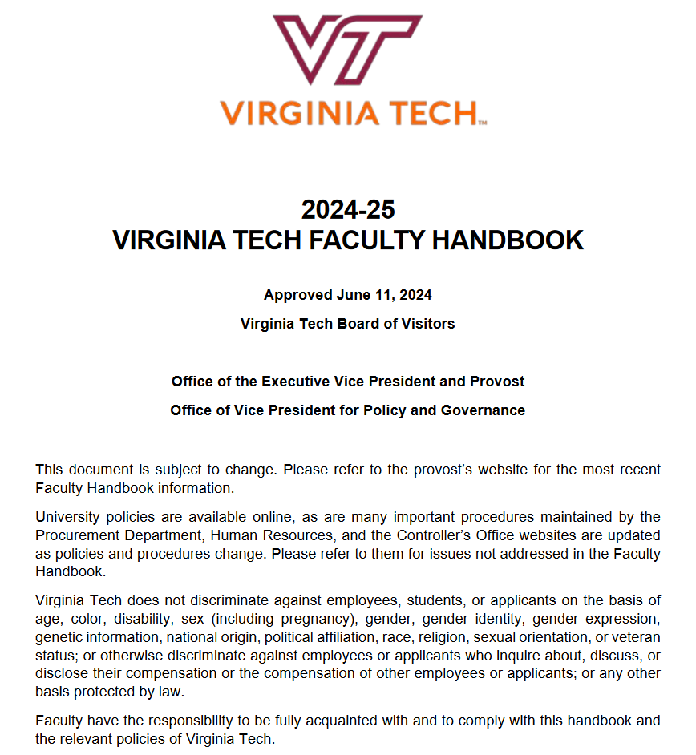
P&T Governed by Faculty Handbook
Section 3.4 in particular:
3.4 Promotion and Tenure
3.4.1 Pre-Tenure Probationary Period
3.4.2 General Expectations for Promotion and Tenure
3.4.3 Departmental or School Evaluation
for Promotion and Tenure
3.4.4 College Evaluation for Promotion and Tenure
3.4.5 University Evaluation for Promotion and Tenure
3.4.6 Candidate Notification
See https://faculty.vt.edu/faculty-handbook.html

Slide 7
Important Info on Provost’s Website
Dossier template and preparation guidelines
University-level deadlines for promotion and tenure review
P&T Workshop dates
Historical summary of P&T outcomes
See https://faculty.vt.edu/promotion-tenure.html
Notes:
COLLEGE GUIDELINES AND EXPECTATIONS
DEPARTMENT/SCHOOL GUIDELINES AND EXPECTATIONS

Slide 8
PROMOTION AND TENURE PROCESS
Department Level
College Level
University Level
Dossier
P&T Comm.
Head
P&T Comm.
Dean
P&T Comm.
Provost
External Letters
BOV
President
Notes:
WALK THROUGH THE PROCESSS INCLUDING TIMING
STARTS THE SPRING BEFORE WITH SELECTION OF CANDIDATES
DON’T FORGET COI ISSUES WITH EXTERNAL LETTER WRITERS
PROMOTION AND TENURE SCHEDULE
April/May Departments evaluate candidates for promotion
June External reviewers selected and invited
July/August Dossiers completed and sent to external reviewers
October Department committee and head review
November Dossiers sent to college
Dec/Jan College committee and dean review
Jan/Feb Dossiers submitted to Provost office from colleges
Materials distributed to university committee
March/April University committee and provost review
April Provost makes recommendations to President
June President submits recommendations to BOV
BOV approval – faculty notified
Sept/Oct Reception for promoted faculty

Slide 9
PROMOTION AND TENURE DOSSIER OUTLINE
I. Executive Summary
II. Recommendation Statements
III. Candidate’s Statement
IV. Teaching and Advising Effectiveness
V. Research and Creative Activities
VI. International & Professional Service and Other Outreach & Extension Activities
VII. University Service
VIII. Work Under Review or In Progress
IX. Other Pertinent Activities
See https://faculty.vt.edu/promotion-tenure.html
Notes:
SEE PROVOST’S SITE FOR DOSSIER TEMPLATE
TWO IMPORTANT NOTES:
DEPTS SHOULD NOT LEAVE DOSSIER PREP ENTIRELY UP TO THE CANDIDATE – REVIEW AND PROVIDE FEEDBACK AND MENTORSHIP
ONCE THE DOSSIER IS PUT INTO THE FORMAL REVIEW PROCESS IT CANNOT BE CHANGED (SUBSTANTIVELY)

Slide 10
Some important dossier details
Executive Summary Tables
Table columns for before and since last promotion or before and since coming to VT, whichever is later
External Reviewers
You get to recommend some external reviewers; your department picks from your list and others they choose independently (at least three)
Be strategic about your recommendations
External reviewers asked to self-disqualify if they violate “too close” criteria
Can’t be former advisor, post-doc supervisor, grant co-I, coauthor on recent pub(s)
“Recent” publications now defined by NSF criteria: within the last four years, though colleges can make this more stringent (increase the length of time)
Do not recommend colleagues who do not meet the previous criteria
Do not contact your reviewers or others who may have been asked
New form for candidates to certify their external reviewer nominees

Slide 11
Some REMINDERS
Progress Reviews
Two progress reviews for promotion to associate are required
Peer Teaching Evaluations
At least two required and they should be thorough and span different points in time
This is so committees don’t have to just use SPOT scores to evaluate teaching
Departmental/College Expectation Documents
Refer to the expectation documents for your department/college
They provide guidance on what is expected to be successful
Candidate Evaluation and Notification
Candidates must be notified at each stage in the process
Candidates may only be evaluated twice (“two-bites rule”)
No Dossier Revision After Submission
Department head or dean’s letter used to communicate new information

Slide 12
Best practices
Ron fricker, vice provost for faculty affairs &
Cyndi Hutchison, Project Director for faculty affairs

Slide 13
BEST PRACTICES
Follow the dossier guidelines carefully and scrupulously
Don’t take someone’s from a previous year and modify it
Don’t be creative with the template, just follow the format
Do ask colleagues, mentors, and dept. leaders to review and make recommendations and editing suggestions
Do make sure everything adds up and is consistent
Work, and rework, your candidate statement
Can only be four pages in length (double spaced)
It’s your opportunity to put your work in context and to emphasize impact
Start with an introductory statement about your professional identity
Explain the character, coherence, direction, and purpose of your scholarly and professional work
Put it in the context of the broad field(s) in which you are working
Statement should enable members of the university promotion and tenure committee to understand clearly your professional aims and achievements
Put it in terms everyone can understand (i.e., do not use specialized jargon)
Get colleagues outside of your field to read it; if they can’t understand what you do and why it’s important, revise, revise, revise

Slide 14
P&T POLICIES AND PRACTICES
POLICIES
2nd and 4th year progress reviews
Tenure clock extension(s)
Modified duties
Non-mandatory promotion to associate with tenure
See memo dated September 21, 2022
PRACTICES
Mentoring
P&T Workshops
P&T Committee and Heads
Promotion to Professor
College-based workshops
Written expectations and standards

Slide 15
KEY RESOURCES
Colleagues
Professors in your department/school
Department head, chair, or school director
Members of the departmental P&T committee
Mentors and other professional colleagues
References
Faculty Handbook, chapter 3
Provost’s website
Promotion and Tenure Guidelines
Dossier Template and Cover Page
College and/or departmental expectations and procedural documents

Slide 16
MY BEST ADVICE
Solicit Input and Advice, Early and Often
Seek advice and input from many and varied colleagues and mentors
Listen to that advice

Slide 17
P&T PERSPECTIVES
Department Head
Dean
University P&T Committee
Views from Recently promoted faculty

Slide 18
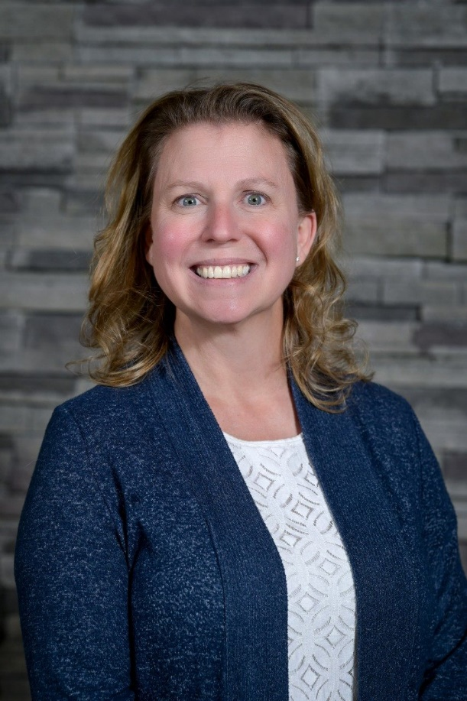
Department head’s PERSPECTIVE
Renee Boyer
Professor, Food Science & Technology

Slide 19
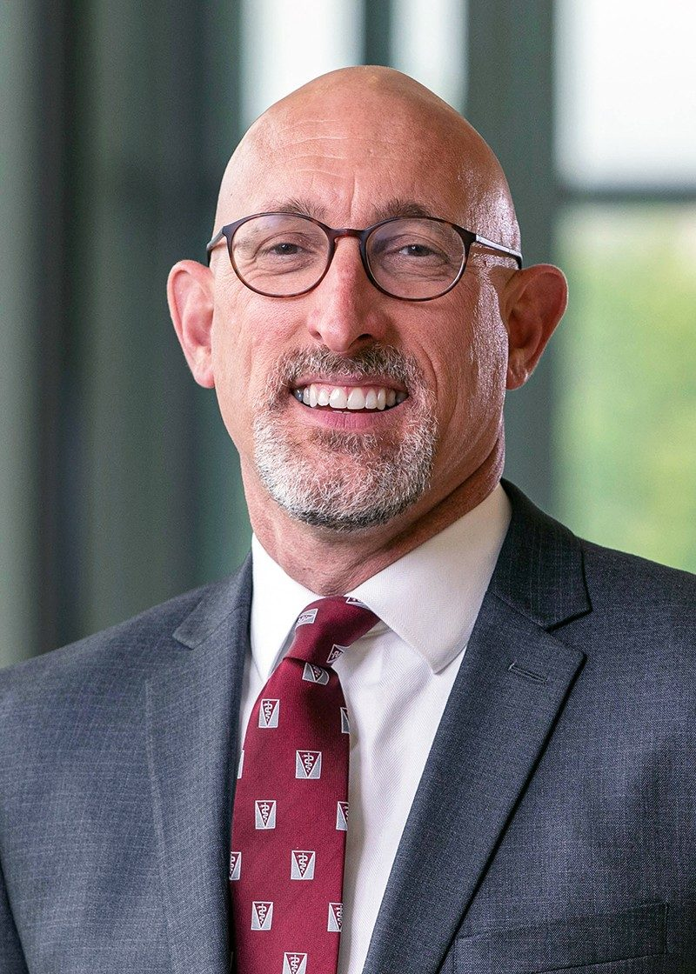
Dean’s PERSPECTIVE
Dan Givens
Virginia-Maryland College of Veterinary Medicine

Slide 20
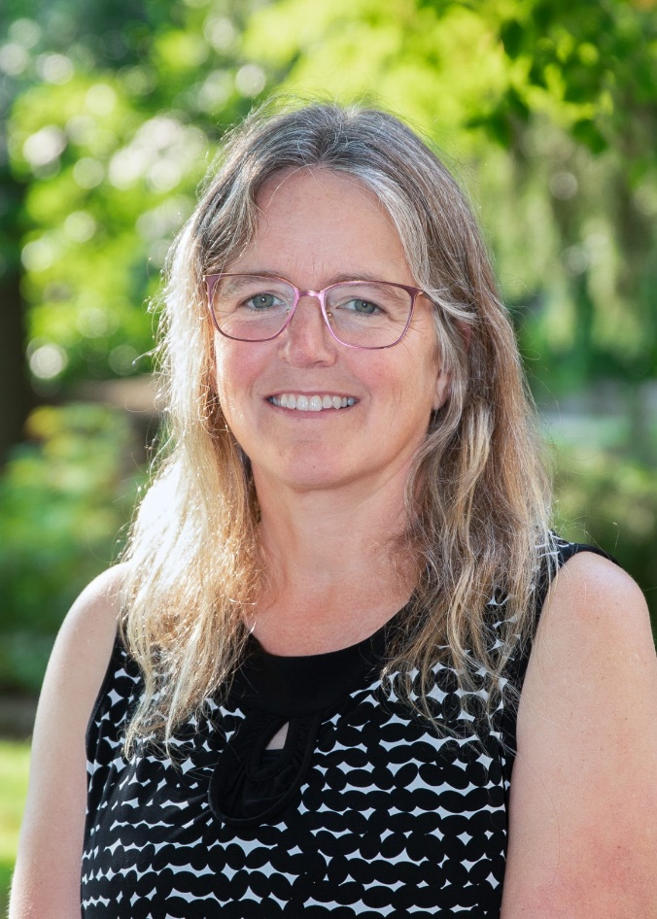
University committee PERSPECTIVE
Valerie Thomas
Professor, Forest Resources and Environmental Conservation

Slide 21
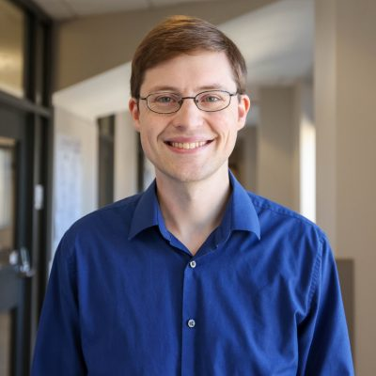
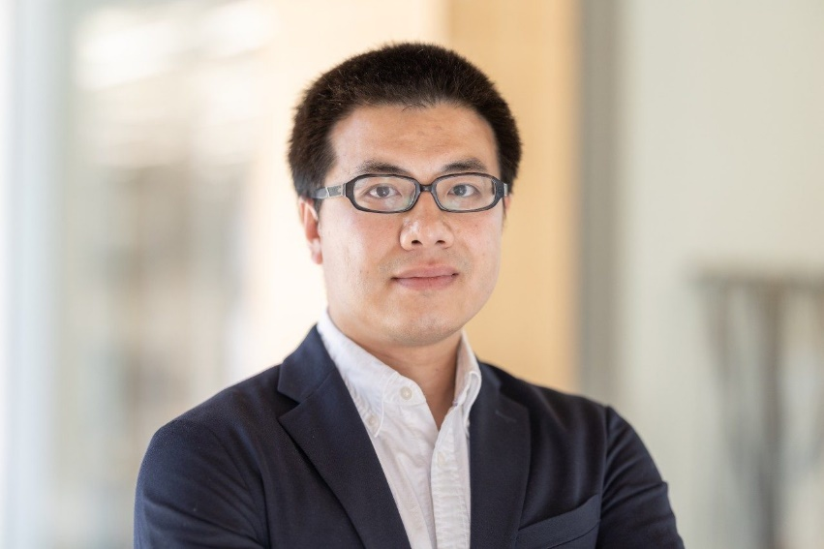
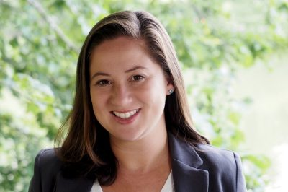
PERSPECTIVEs from recently promoted faculty
Dong Dong, Associate Professor Electrical and Computer Engineering
Karin Kitchens, Associate Professor Political Science
Michael Schulz, Associate Professor Chemistry

Slide 22
Questions and discussion
Visit the Promotion and Tenure website for more information:
https://faculty.vt.edu/promotion-tenure.html

Slide 23
OTHER RESOURCES

Slide 24
COVID-19 IMPACT CONSIDERATIONS
Faculty COVID statements
Inclusion of cancelled/postponed and/or virtual presentations
SPOT scores for calendar year 2020 optional
Tenure Clock Extensions
Work assignment adjustments
Modified duties
External letter reuse
See https://faculty.vt.edu/promotion-tenure/adaptations-promotion-tenure-process.html

Slide 25
COLLEGE P&T GUIDELINES
College of Agriculture and Life Sciences
College of Architecture, Arts, and Design
College of Engineering
College of Liberal Arts and Human Sciences
College of Natural Resources and the Environment
College of Science
Pamplin College of Business
Virginia-Maryland College of Veterinary Medicine
Virginia Tech Carilion School of Medicine

